Slide 1

Introduction:
  Basic Concepts and Notations
  Complexity analysis: time space tradeoff
  Algorithmic notations, Big O notation
  Introduction to omega, theta and little o notation

Slide 2
Basic Concepts and Notations
Algorithm: Outline, the essence of a computational procedure, step-by-step instructions
Program: an implementation of an algorithm in some programming language
Data Structure: Organization of data needed to solve the problem

Slide 3

Classification of Data Structures
Data Structures
Primitive
Data Structures
Non-Primitive
Data Structures
Integer
Real
Character
Boolean
Linear
Data Structures
Non-Linear
Data Structures
Array
Stack
Queue
Linked List
Tree
Graph
Notes:
목차
자바의 생성배경
자바를 사용하는 이유
과거, 현재, 미래의 자바
자바의 발전과정
버전별 JDK에 대한 설명
자바와 C++의 차이점
자바의 성능
자바 관련 산업(?)의 경향

Slide 4
Data Structure Operations
Data Structures are processed by using certain operations.
Traversing: Accessing each record exactly once so that certain items in the record may be processed.
Searching: Finding the location of the record with a given key value, or finding the location of all the records that satisfy one or more conditions.
Inserting: Adding a new record to the structure.
Deleting: Removing a record from the structure.
Notes:
목차
자바의 생성배경
자바를 사용하는 이유
과거, 현재, 미래의 자바
자바의 발전과정
버전별 JDK에 대한 설명
자바와 C++의 차이점
자바의 성능
자바 관련 산업(?)의 경향

Slide 5
Special Data Structure-Operations
Sorting: Arranging the records in some logical order (Alphabetical or numerical order).
Merging: Combining the records in two different sorted files into a single sorted file.
Notes:
목차
자바의 생성배경
자바를 사용하는 이유
과거, 현재, 미래의 자바
자바의 발전과정
버전별 JDK에 대한 설명
자바와 C++의 차이점
자바의 성능
자바 관련 산업(?)의 경향

Slide 6
Algorithmic Problem
Specification of input
Specification of output as a function of input
?
Infinite number of input instances satisfying the specification. For example: A sorted, non-decreasing sequence of natural numbers of non-zero, finite length:
  1, 20, 908, 909, 100000, 1000000000.
  3.

Slide 7
Algorithmic Solution
Specification of input
Specification of output as a function of input
Algorithm
Algorithm describes actions on the input instance
Infinitely many correct algorithms for the same algorithmic problem

Slide 8
What is a Good Algorithm?
Efficient:
  Running time
  Space used
Efficiency as a function of input size:
  The number of bits in an input number
  Number of data elements(numbers, points)

Slide 9
Complexity analysis
Why we should analyze algorithms?
  Predict the resources that the algorithm requires
    Computational time (CPU consumption)
    Memory space (RAM consumption)
    Communication bandwidth consumption
  The running time of an algorithm is:
    The total number of primitive operations executed (machine independent steps)
    Also known as algorithm complexity

Slide 10
Time Complexity
Worst-case
  An upper bound on the running time for any input of given size
Average-case
  Assume all inputs of a given size are equally likely
Best-case
  The lower bound on the running time

Slide 11
Time Complexity – Example
Sequential search in a list of size n
  Worst-case:
    n comparisons
  Best-case:
    1 comparison
  Average-case:
    n/2 comparisons

Slide 12
time space tradeoff
A time space tradeoff is a situation where the memory use can be reduced at the cost of slower program execution (and, conversely, the computation time can be reduced at the cost of increased memory use).
As the relative costs of CPU cycles, RAM space, and hard drive space change—hard drive space has for some time been getting cheaper at a much faster rate than other components of computers[citation needed]—the appropriate choices for time space tradeoff have changed radically.
Often, by exploiting a time space tradeoff, a program can be made to run much faster.

Slide 13
Asymptotic notations
Algorithm complexity is rough estimation of the number of steps performed by given computation depending on the size of the input data
  Measured through asymptotic notation
    O(g) where g is a function of the input data size
  Examples:
    Linear complexity O(n) – all elements are processed once (or constant number of times)
    Quadratic complexity O(n²) – each of the elements is processed n times

Slide 14
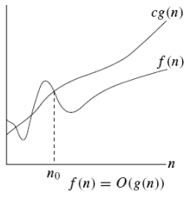

O-notation
Asymptotic upper bound

Slide 15
Example
The running time is O(n²) means there is a function f(n) that is O(n²) such that for any value of n, no matter what particular input of size n is chosen, the running time of that input is bounded from above by the value f(n).
  3 * n² + n/2 + 12 ∈ O(n²)
  4*n*log₂(3*n+1) + 2*n-1 ∈ O(n * log n)

Slide 16
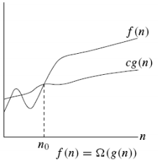

Ω notation
Asymptotic lower bound

Slide 17
Example
When we say that the running time (no modifier) of an algorithm is Ω (g(n)).
we mean that no matter what particular input of size n is chosen for each value of n, the running time on that input is at least a constant times g(n), for sufficiently large n.
  n³ + 20n ∈ Ω(n²)

Slide 18
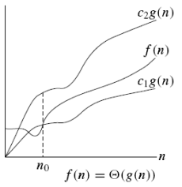

Θ notation
g(n) is an asymptotically tight bound of f(n)

Slide 19

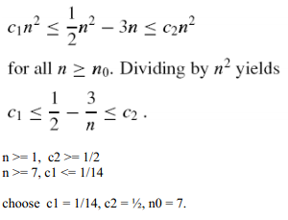
Example

Slide 20
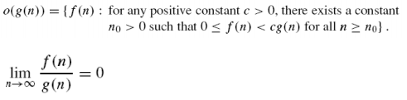
little o notation

Slide 21
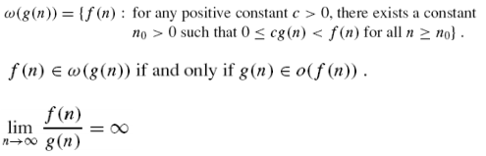
ω-notation

Slide 22
Notes on o-notation
O-notation may or may not be asymptotically tight for upper bound.
  2n² = O(n²) is tight, but 2n = O(n²) is not tight.
o-notition is used to denote an upper bound that is not tight.
  2n = o(n²), but 2n² ≠ o(n²).
Difference: for some positive constant c in O-notation, but all positive constants c in o-notation.
In o-notation, f(n) becomes insignificant relative to g(n) as n approaches infinitely.

Slide 23
Big O notation
f(n)=O(g(n)) iff there exist a positive constant c and non-negative integer n₀ such that
f(n) ≤ cg(n) for all n≥n0.
g(n) is said to be an upper bound of f(n).

Slide 24
Basic rules
1. Nested loops are multiplied together.
2. Sequential loops are added.
3. Only the largest term is kept, all others are dropped.
4. Constants are dropped.
5. Conditional checks are constant (i.e. 1).

Slide 25
Example 1
//linear
for(int i = 0; i < n; i++) {
cout << i << endl;
}

Slide 26
Ans: O(n)

Slide 27
Example 2
//quadratic
for(int i = 0; i < n; i++) {
for(int j = 0; j < n; j++){
//do swap stuff, constant time
}
}

Slide 28
Ans O(n^2)

Slide 29
Example 3
for(int i = 0; i < 2*n; i++) {
cout << i << endl;
}

Slide 30
At first you might say that the upper bound is O(2n); however, we drop constants so it becomes O(n)

Slide 31
Example 4
//linear
for(int i = 0; i < n; i++) {
cout << i << endl;
}
//quadratic
for(int i = 0; i < n; i++) {
for(int j = 0; j < n; j++){
//do constant time stuff
}
}

Slide 32
Ans : In this case we add each loop's Big O, in this case n+n^2. O(n^2+n) is not an acceptable answer since we must drop the lowest term. The upper bound is O(n^2). Why? Because it has the largest growth rate

Slide 33
Example 5
for(int i = 0; i < n; i++) {
for(int j = 0; j < 2; j++){
//do stuff
}
}

Slide 34
Ans: Outer loop is 'n', inner loop is 2, this we have 2n, dropped constant gives up O(n)

Slide 35
Example 6
for(int i = 1; i < n; i *= 2) {
cout << i << endl;
}

Slide 36
There are n iterations, however, instead of simply incrementing, 'i' is increased by 2*itself each run. Thus the loop is log(n).

Slide 37
Example 7
for(int i = 0; i < n; i++) { //linear
for(int j = 1; j < n; j *= 2){ // log (n)
//do constant time stuff
}
}

Slide 38
Ans: n*log(n)

Slide 39




Comp 122

Slide 40
Thank You

